Slide 1

Concept Of Database System
Fall 2019

Slide 2
Team Member
I Hua Tsai
Chang Liu
Jiayu Yan
Andrew Nwalie

Slide 3

Outline
Conceptual Database Design
Logical Database Design
Physical Database Design
Validation of Relational Data Model
Conclusion
Acknowledgment

Slide 4
Conceptual Database Design
ER model: Object, Attributes, Relationships

Slide 5
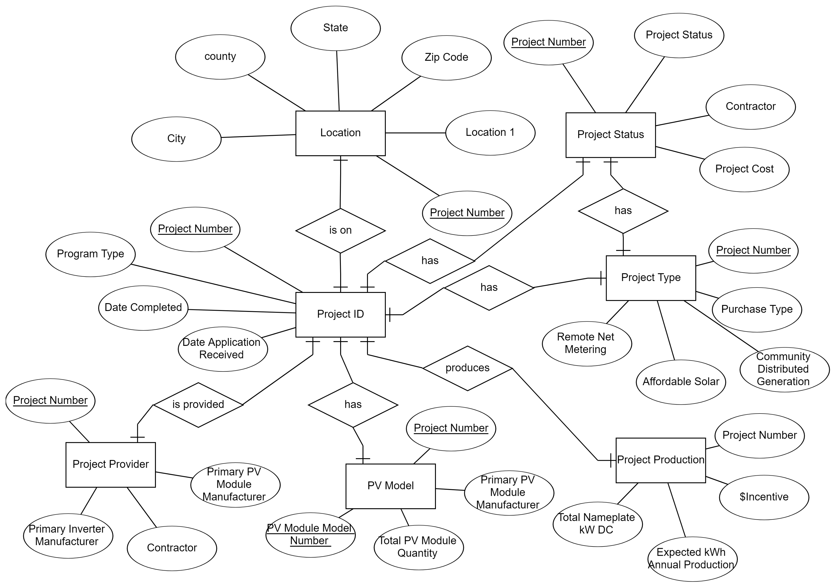
Main ER model

Slide 6
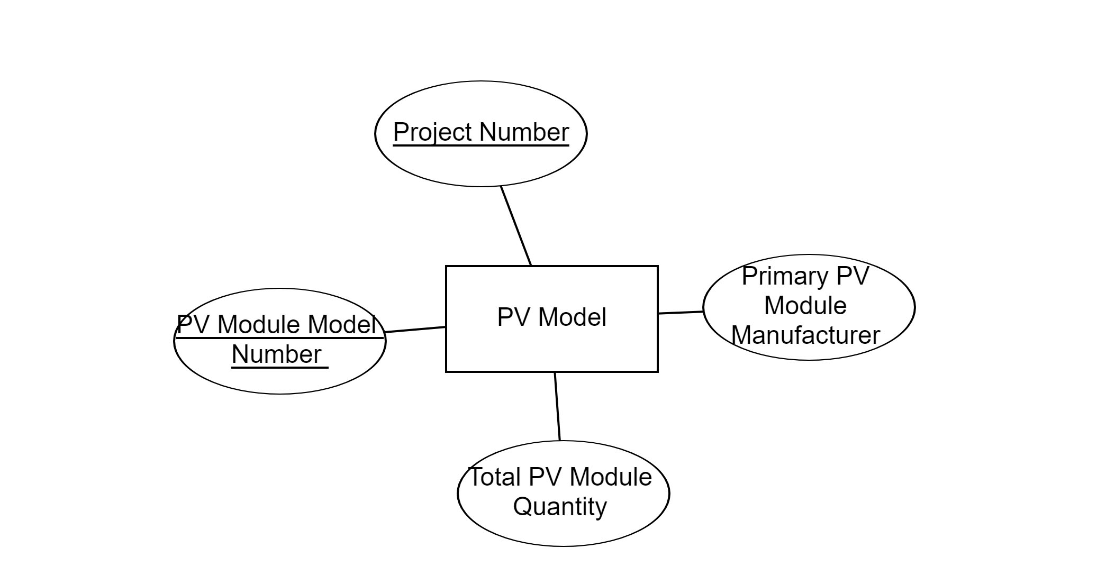
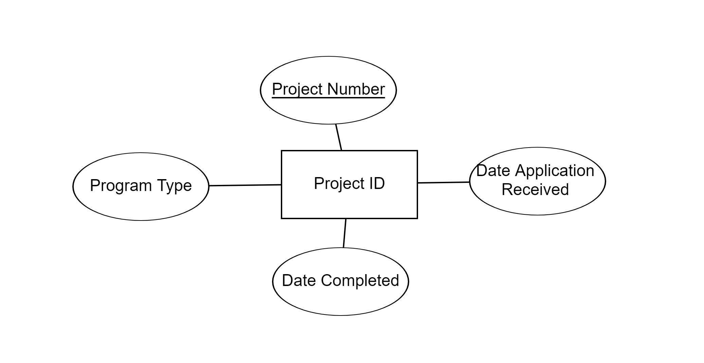
PV Model
Project ID

Slide 7
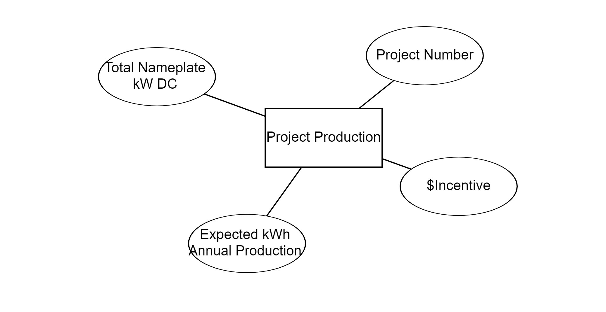
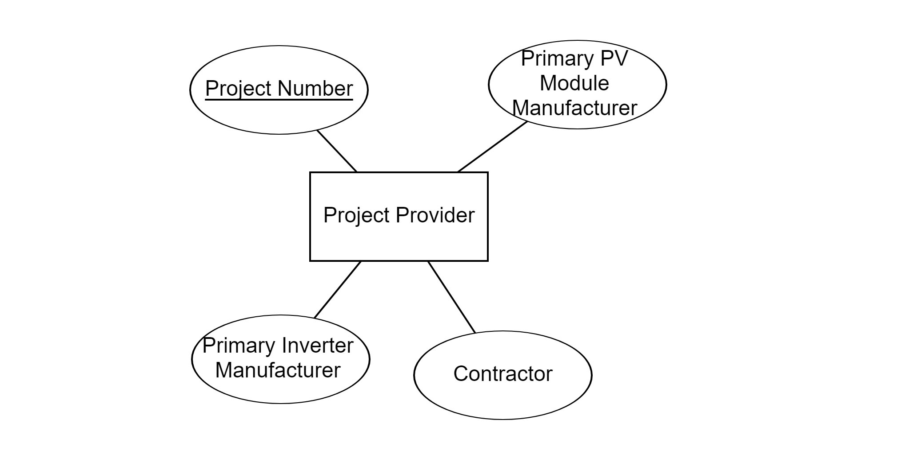
Project Production
Project Provider

Slide 8
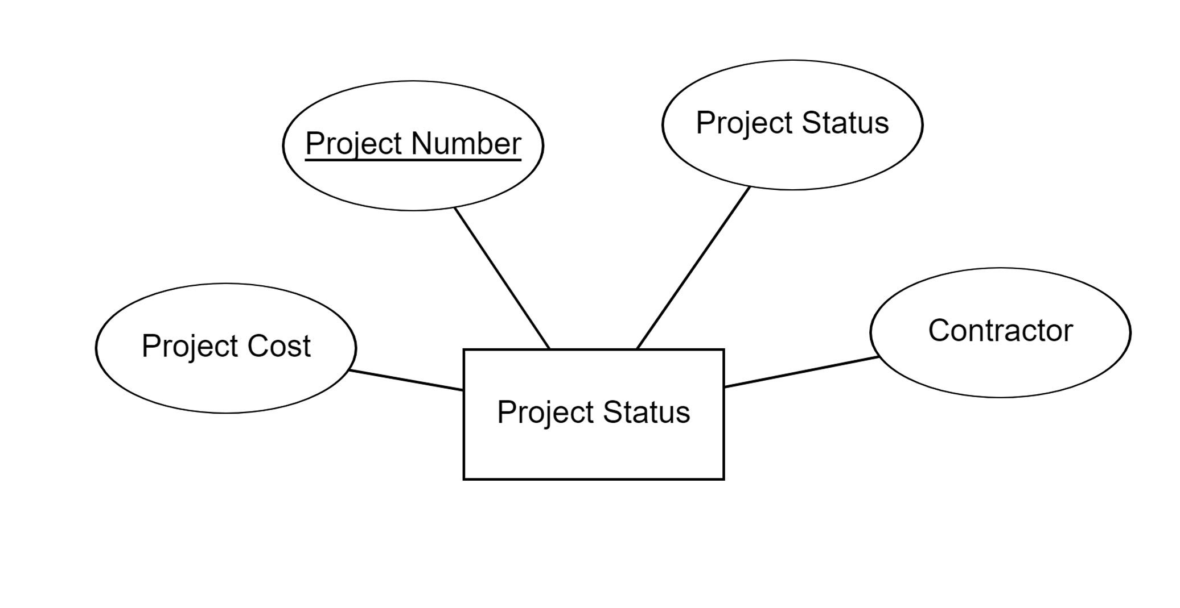
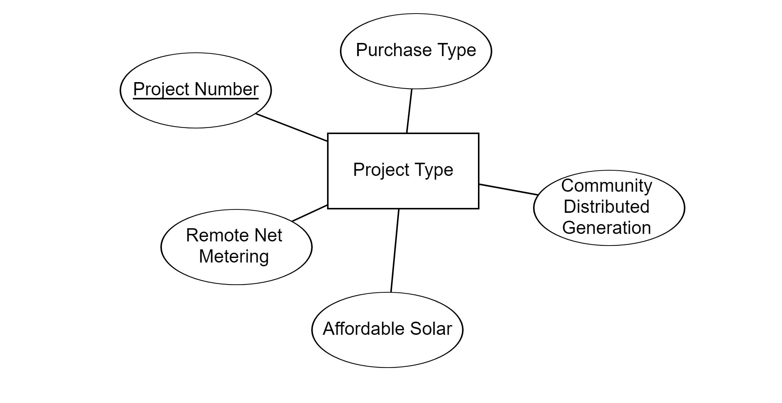
Project Status
Project Type

Slide 9
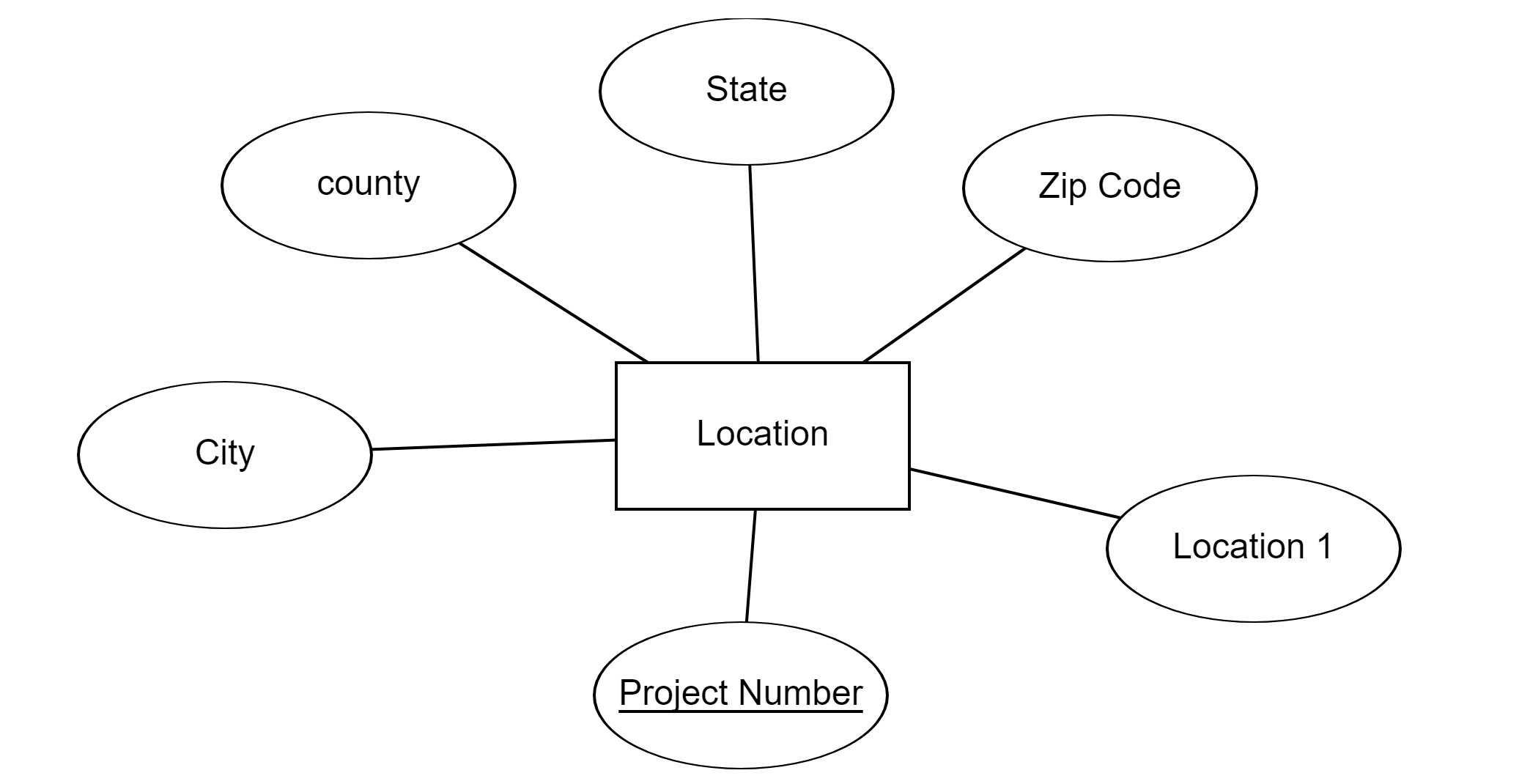
Location

Slide 10
Logical Database Design
Normalization, 3NF

Slide 11
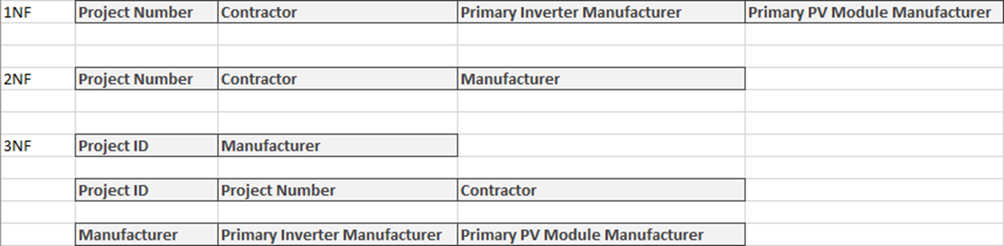
Normalization

Slide 12
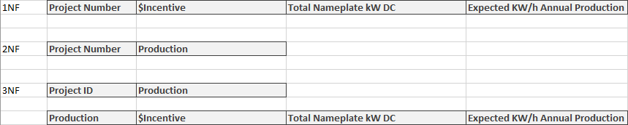
Normalization

Slide 13
Physical Database Design
Create database table
Design user views

Slide 14
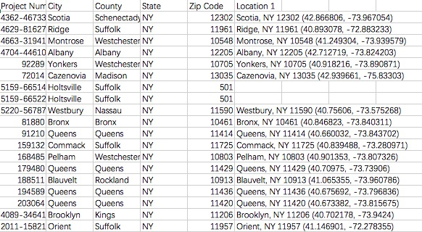
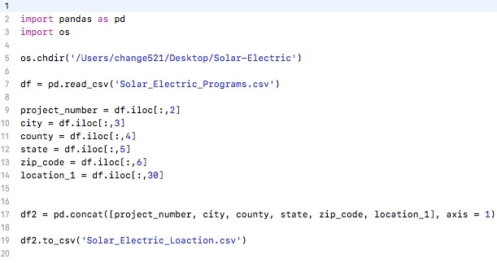
Location
Database Table
Py Code

Slide 15
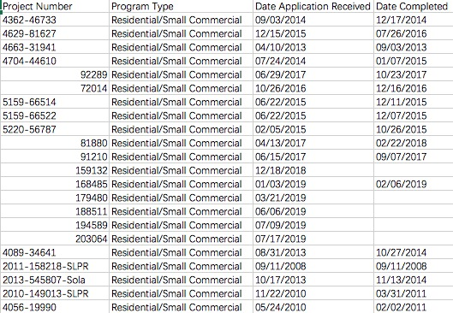
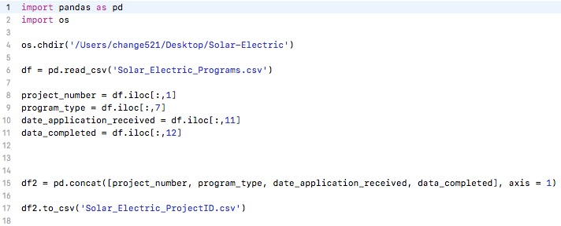
Project Completed Year
Database Table
Py Code

Slide 16
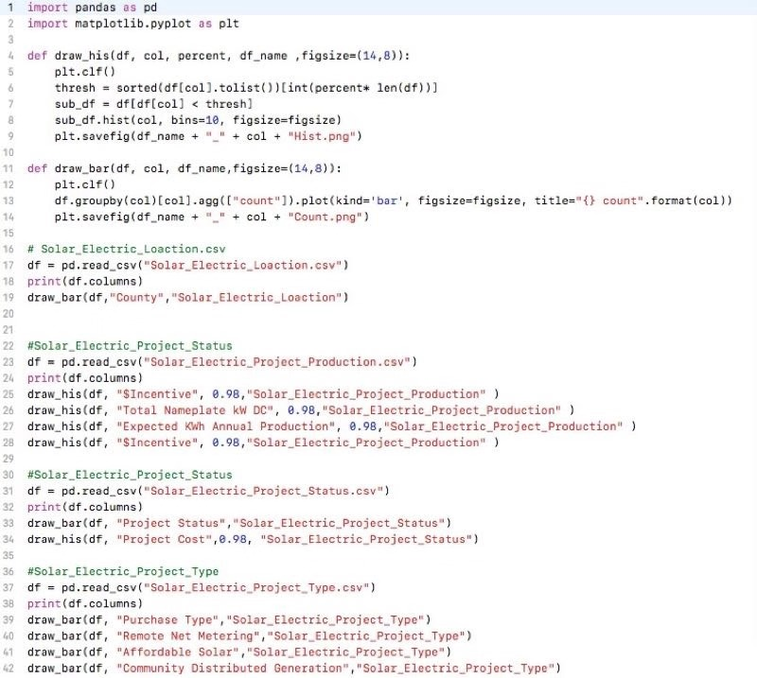
Main Code

Slide 17
Validation of Relational Data Model
Visualize your query results

Slide 18
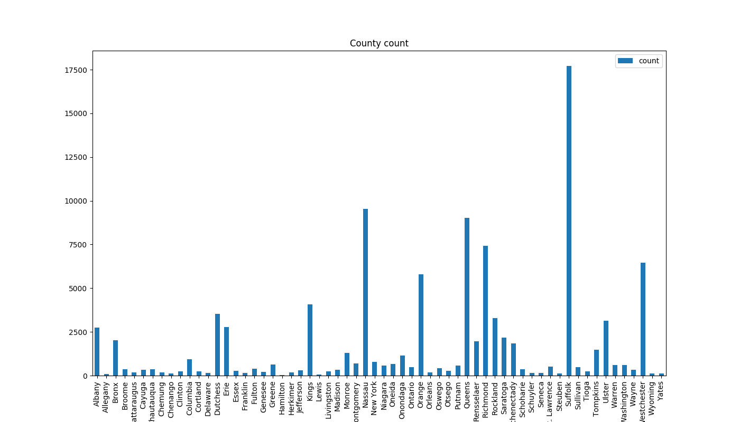
Location

Slide 19
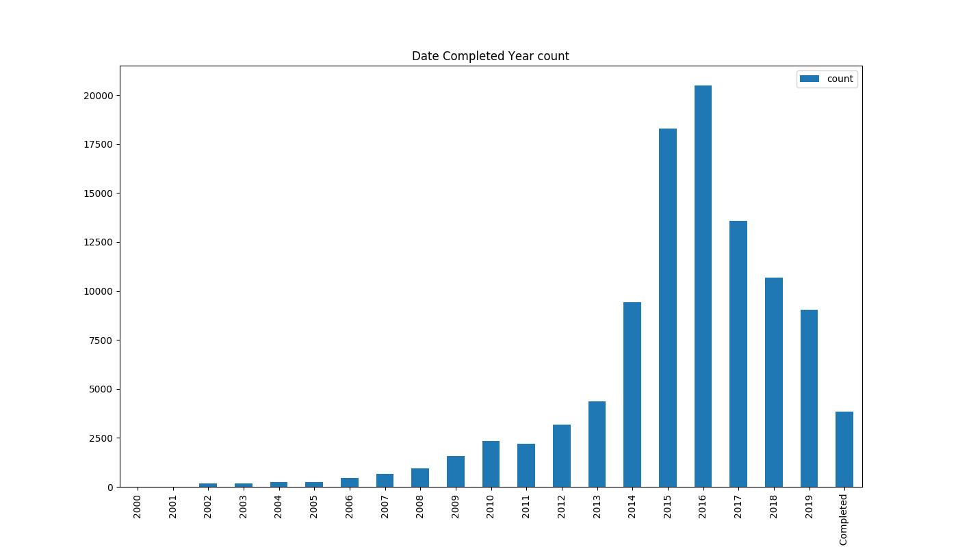
Project Completed Year

Slide 20
Project Related Link:
Repository Page: https://github.com/change521/CS4353_Final_Project/
Website Page: https://dyaniel96.github.io/CS4354Project/

Slide 21
Conclusion
Conceptual Database Design: Figuring out the interaction of different relations is challenging.
Logical Database Design: A lot of data to go through to decide if they accurately depend on each other
Physical Database Design: It takes a lot of time to find the relevance of the data.
Validation of Relational Data: Some data cannot form a perfect graph.

Slide 22
Member’s Contribution
Chang Liu: Physical Database Design and Validation of Relational Data Model
Jiayu Yan: Conceptual Database Design and Create Web
I-Hua Tsai: Physical Database Design and Unified Data
Andrew Nwalie: Logical Database Design and Conceptual Database Design

Slide 23
Thank you

